Slide 1


Finnish Water Sector
Managing Director
D.Sc. Topi Helle
Finnish Water Forum

Slide 2
VISION
Clean water for everyone
MISSION
Finnish Water Forum’s mission is to create sustainable solutions for global water, climate and biodiversity challenges with Finnish know-how and technology jointly with local and international actors

Slide 3
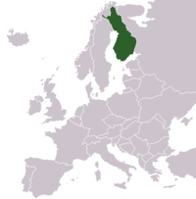
Finnish Water Forum – who we are?
  Finnish Water sector association
  Non-Profit organization
  Members (>130) include
    Ministries
    Universities and educational institutions
    Research Institutions
    Associations
    Private sector companies
  Members knowledge covers all areas of water
  FWF is the “one stop shop” to Finnish Water partners
FINLAND

Slide 4


Faintend
Ekonia Biwatech
Planpoint
International Trade Alliance

Slide 5


Sustainable ways to reach
SDG 6 clean water and sanitation
  Digitalization is important tool for sustainable water management, good water quality and safety
  Circular economy and resource efficiency solutions, such as waste water recycling or sludge into biogas and fertilizers
  Capacity building is also important – we need competent and skilled staff at private and public sectors to use sustainable solutions
  We have good water quality and Finland has been ranked number 1 in water quality assessment among 122 countries (UN World Water Assessment Programme)
There are 17 UN sustainable development goals and many of them are related to water

Slide 6
Good water quality
Quality water
Regulation
Research
Technology
Planning & Implementation
Maintenance & Management
Users
Education
Authorities & Administration
Legistlation
  All these elements are needed to guarantee sustainability of Quality Water

Slide 7





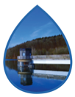



FINNISH WATER SECTOR STRONGHOLDS
Risk management of water supply and sanitation
Education and capacity building
Water resources management and lake restoration
Managed aquifer recharge for drinking water production
Flood and drought prevention & natural storm water management
Dam safety – preparedness
in long-term
Modular off-grid water solutions
Environmental monitoring and smart water
Waste water into energy, fertilizers and water re-use
info@fwf.fi
www.fwf.fi

Slide 8

RISK MANAGEMENT OF WATER SUPPLY
AND SANITATION
In Finland, safe quality of drinking water is assured by a comprehensive approach on all risks related to the process.
A national online platform used by more than 500 water utilities provides the utilities and also national and local authorities reliable information on most significant risks, urgent investment needs and progress of the whole sector.
Solutions include:
Software for systematical risk assessment and documentation
Identification of required actions and investments for more efficient implementation
Unified information and tools for follow-up and benchmarking of the progress
info@fwf.fi
www.fwf.fi

Slide 9

WASTE WATER INTO ENERGY, FERTILIZERS
AND WATER RE-USE
Finland is a forerunner in water-related circular economy and resource efficiency.
Waste water is used as a resource for producing bio-energy, safe fertilizers and water for industry, agriculture and municipalities. Future solutions of waste water treatment already exist in Finland and can be implemented also elsewhere - protecting the environment and saving scarce water resources.
Solutions include:
Design, planning, technology & construction of modern treatment plants
Secured environmental safety and energy & resource efficiency
Underground treatment plants for maximized land-use efficiency
info@fwf.fi
www.fwf.fi

Slide 10

ARTIFICIAL GROUNDWATER FOR DRINKING WATER PRODUCTION ie. MANAGED AQUIFER RECHARGE (MAR)
Artificial groundwater is one of the main water sources of Finnish water utilities.
Using surface water to recharge aquifers is a very cost-efficient method for drinking water production, but requires good knowledge on the local conditions and high-level expertise for successful implementation. Finnish actors have wide experience of practical and sustainable solutions.
MAR can also be used for water storage.
Solution includes:
Geological and raw water surveys
Feasibility studies, planning & design
Measuring and monitoring technologies
Construction supervision
info@fwf.fi
www.fwf.fi

Slide 11

WATER RESOURCES MANAGEMENT
AND LAKE RESTORATION
Key to Finland’s clean waters is the holistic approach on environmental monitoring and decision-making.
Most of the acquired information is open data to enable efficient cooperation and boost the creation of innovative solutions. Contamination sources are quickly identified with real-time monitoring and effectively eliminated with supportive regulation. Several polluted reservoirs have been restored.
Solutions include:
Modelling and planning of suitable restoration methods and practices
Monitoring and prevention of external loads (urban, rural, agricultural and industrial wastewater)
Baseline information on hydrological conditions and pollution sources
info@fwf.fi
www.fwf.fi

Slide 12

FLOOD AND DROUGHT PREVENTION
& NATURAL STORM WATER MANAGEMENT
Flood and drought prevention is a critical issue on both rural and urban areas.
In rural areas, flash floods can be prevented with the support of advanced geological surveys, land use planning and identifying suitable areas for retention and infiltration. In urban areas, a successful solution can include thorough analysis of land use, use of evaporation areas and permeable surfaces.
Extreme weather conditions cause also drought and need for irrigation.
Solution includes:
Training, consulting, planning & design
Early warning systems & monitoring & measurement technologies
Irrigation and flood management
Policy development
Small scale demonstrations for replication and scaling up
info@fwf.fi
www.fwf.fi

Slide 13
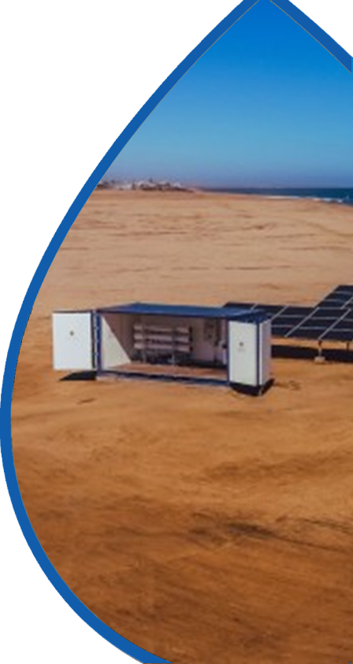
MODULAR OFF-GRID WATER SOLUTIONS
Modular container solutions can be used in remote villages, holiday resorts and industrial applications to produce clean water and treating waste water
Also rescue and recovery from disasters and crises requires quick access to WASH.
All water can be made drinkable. Finnish innovations in water purification, wastewater treatment and recycling, together with water saving and managing solutions, can save lives in emergency and recovery settings.
Solutions includes:
Comprehensive solutions for crisis management and WASH related challenges
Deployable, modular and scalable solutions for field camps and other temporary or permanent needs
Smart solutions for drinking and wastewater management to secure health, safety and efficiency
info@fwf.fi
www.fwf.fi

Slide 14

EDUCATION AND CAPACITY BUILDING
Capacity building is also important for sustainability – we need competent and skilled staff at private and public sectors to adopt sustainable water solutions
Finland has helped in capacity building for decades. Finland is also known for good results in education, such as in PISA tests for school children.
In addition to education and capacity building, Finland can help with schools sanitation, waste water treatment and clean water. This is important to give good infrastructure for good learning.
Solution includes:
Certified vocational training in water
Tailored courses for engineers and authorities
Degree courses in water management for MSc level
Professional teacher education
info@fwf.fi
www.fwf.fi

Slide 15


ENVIRONMENTAL MONITORING AND
SMART WATER SOLUTIONS
Reliable real-time data is essential for modern water management
Smart water management solutions can be used to reduce water losses in potable, irrigation and waste water networks
When contamination sources are identified in real-time, quick actions can be taken to prevent any problems. With novel sensor technologies, new parameters can be measured to improve decision-making of water resources management.
Most sustainable way to produce water is to reduce water losses – there will be savings in energy, chemicals and water. Digital monitoring, access control to different fasilities and cyber security will guarantee safe operation of water network.
Solutions includes:
Integrated technologies, sensor networks and monitoring
Predictive monitoring system for comprehensive management
Improved system performance with safe E2E connections, hydraulic models, GIS, open-data and various algorithms
info@fwf.fi
www.fwf.fi

Slide 16

Thank You for Your attention!
You can find more information from
www.fwf.fi
https://www.linkedin.com/company/finnish-water-forum/

