Slide 1
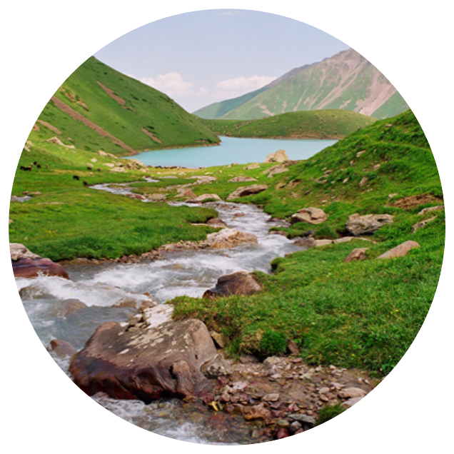
Capacity building for monitoring and management of surface waters
25.3.2022
Tea Törnroos, Head of International Services
Finnish Environment Institute

Slide 2
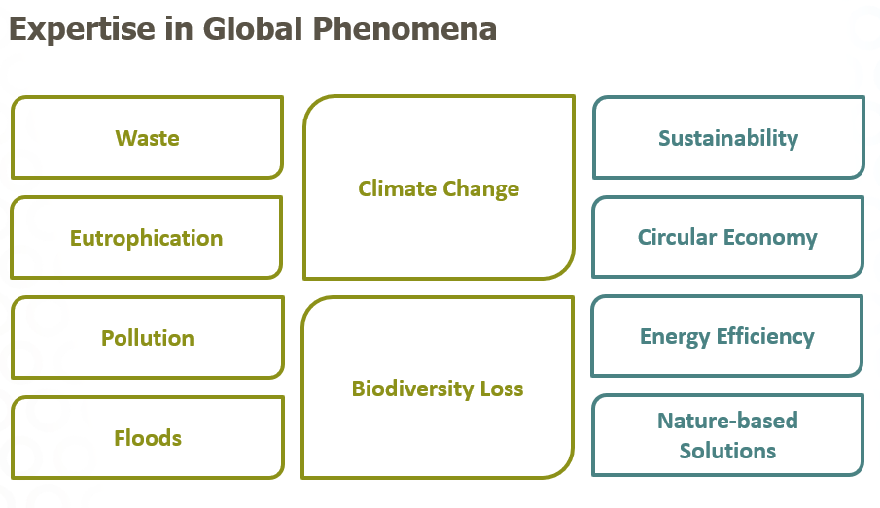
Finnish Environment Institute - SYKE
SYKE supports the building of a sustainable society with research, information and services.
Versatile water expertise and solutions to address global phenomena
Works under supervision of Ministry of the Environment and Ministry of Agriculture and Forestry of Finland
Personnel around 650

Slide 3
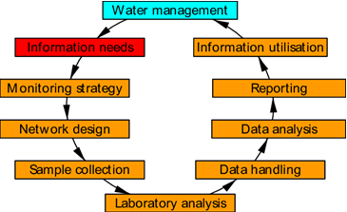
SYKE’s environment and water projects in Central-Asia - collaboration since 1998
Long term knowledge exchange and cooperation between Kyrgyz and Finnish environmental administrations with special focus on water quality monitoring
Good water quality monitoring practices introduced to Tajikistan since 2015
Links to regional collaboration (Chu-Talas basin; the Regional Expert Group on Water Quality)

Slide 4
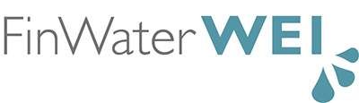
Programme for Finland’s water sector support to Kyrgyzstan and Tajikistan (coordinated by SYKE 2014-2018)
Multiannual partnership aiming at enhancing water security in Kyrgyzstan and Tajikistan through equitable and integrated management of water resources
Implementation through multiple partnerships
  International organisations (UNECE, OECD, UN Women, WHO, OXFAM, AKF)
  Bilateral capacity building projects addressing water quality monitoring
  Wide range of national partners from various ministries and agencies as well as NGO’s
Policy support, capacity building, empowering communities
Climate change and gender equality cross-cutting themes

Slide 5

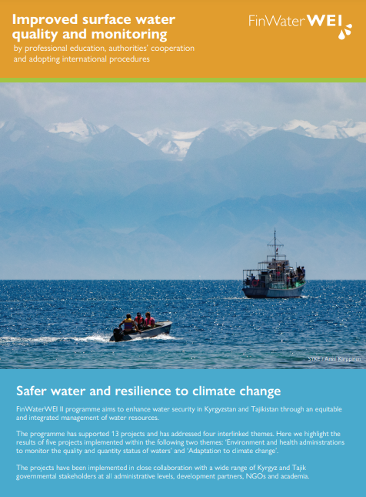
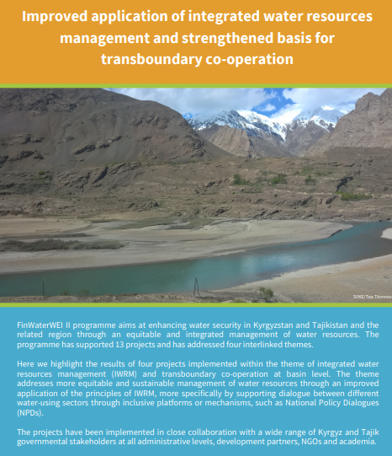
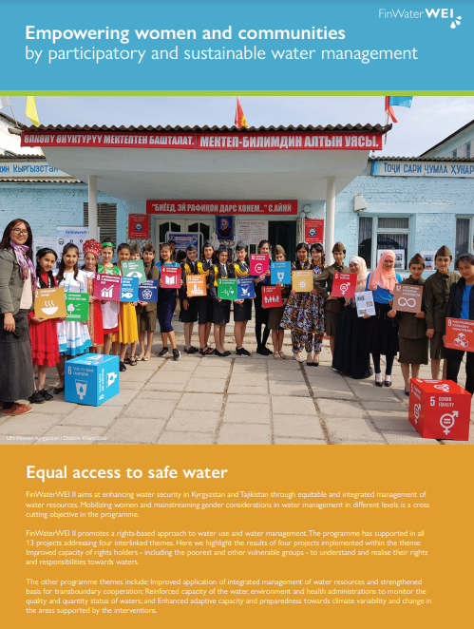
https://www.syke.fi/en-US/FinWaterWEI_II
Notes:
Enhancing water security at local, national and regional levels
KV-järjestöt (UNECE, OECD, UN Women, WHO, OXFAM, AKF)
Kahdenväliset kumppanuudet (IKI)
Mukana laajasti hallinto ja järjestöt kumppanmaista
National Policy Dialogs (NPDs)
In all 13 projects supported (incl. bilateral capacity building projects, policy support, hanketta, joista osa alueellisia
Larger programme with a total budget 8 meur

Slide 6
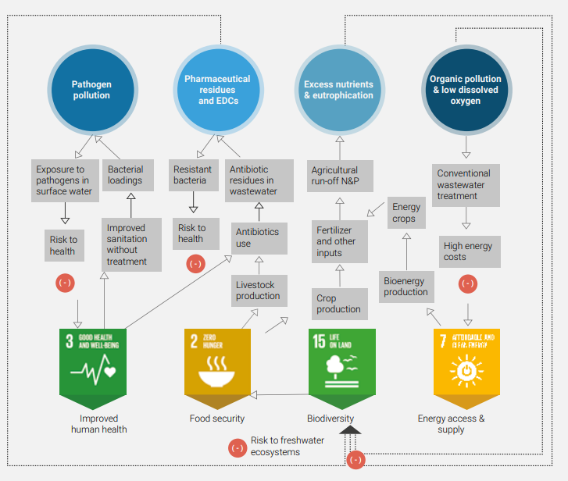
Ongoing projects
Consolidating Institutional Capacities for National Surface Water Quality Monitoring in the Kyrgyz Republic (KGZ-Water III), MFA, 2021-2023
Development of Tajik surface Water Monitoring by Quality Management and Collaboration (TJK Water Quality II), MFA, 2021-2023
    Underway also preparations of a new ICI-project addressing water quality monitoring project in Uzbekistan

Slide 7
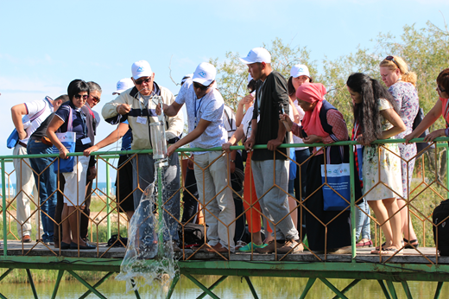
Consolidating Institutional Capacities For National Surface Water Quality Monitoring In The Kyrgyz Republic - Kgz-Water III
  Clearly defined implementation of the national Joint Water Quality Monitoring Programme
  Broadened service provision and financial sustainability of water quality monitoring
  laboratories of MNRETS and Kyrgyzhydromet
  Enhanced access to surface water quality data
  for authorities and stakeholders
  Established information dissemination practises
  on surface water quality to stakeholders and the
  public
  Kyrgyz partners: Ministry of Natural Resources, Ecology
  and Technical Supervision (MNRETS); Kyrgyzhydromet
  Duration: 7/2021-12/2023
  Budget: 850.000 €
  https://www.syke.fi/en-US/Research__Development/Research_and_development_projects/Projects/KGZWater_III

Slide 8
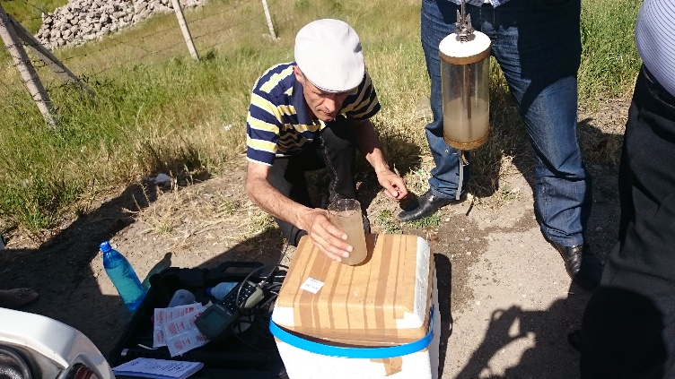
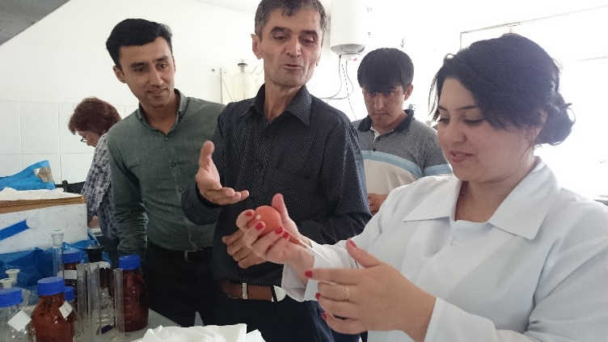
Development of Tajik surface Water Monitoring by Quality Management and Collaboration - Tjk Water Quality II
  Improved surface water quality data through application of ISO 17025 standards in water laboratories
  New management practices and new forms of collaboration applied in quality management
  Surface water quality data comprehensively submitted to the water database and widely accessed
  Increased understanding of stakeholders and general public on surface water quality (awareness raising)
  Tajik partners: Committee of Environmental Protection; Hydrometeorological Agency
  Duration: 7/2021-12/2023
  Budget: 750.000 €

Slide 9
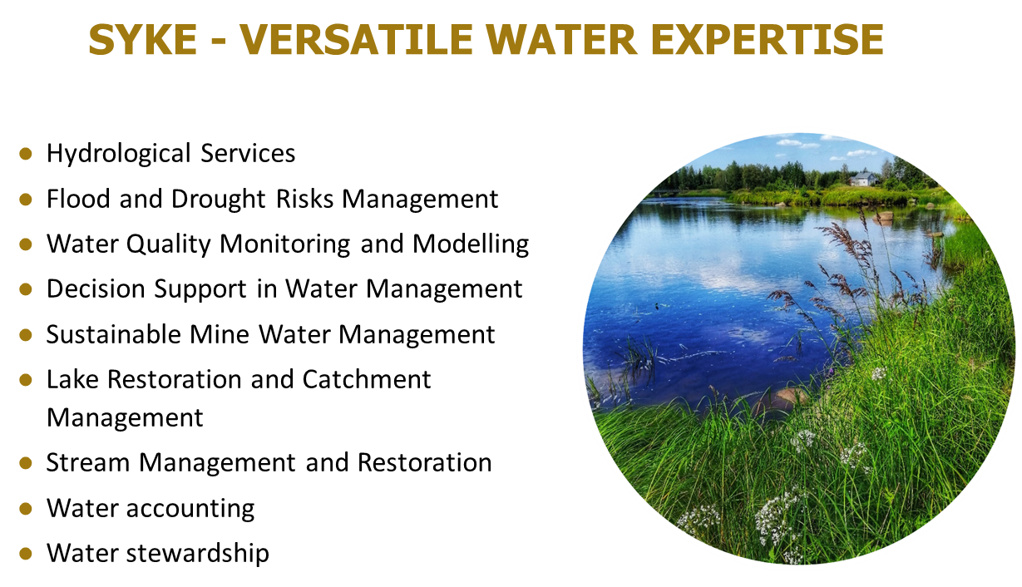

Slide 10
SYKE’s project references from Central Asia
Consolidating Institutional Capacities for National Surface Water Quality Monitoring in the Kyrgyz Republic (KGZ-Water III), MFA, 2021-2023
Development of Tajik surface Water Monitoring by Quality Management and Collaboration (TJK Water Quality II), MFA, 2021-2023
Programme for Finland's Water Sector Support to Kyrgyzstan and Tajikistan (FinWaterWEI II), MFA, 2014-2019
Capacity Building of the Kyrgyz Republic on Son-Kul Lake status assessment for environmentally sustainable development (KGZ-Water / Son-Kul), MFA 2016-2018
Formation of Decision-Making System Aimed at Ecological and Economic Development of Issyk-Kul Lake's Territory Based on Results of Environment Monitoring (KGZ-Water / Issyk-Kul MFA, 2014-2018
Capacity building on surface water quality monitoring in Tajikistan (TJK-Water MFA, 2015-2018
Water Quality Monitoring in the Kyrgyz Republic, MFA, 2011-2014
Administration and Support of the Strategic Cooperation Programme for Finland's Water Sector Support to the EECCA Countries (FinWaterWEI), MFA, 2010-2013
Environmental Monitoring and Management Capacity Building in the Kyrgyz Republic (Finnish Ministry for Foreign Affairs, 1998-2006)

Slide 11
For more information:
Websites:
Finnish Environment Institute SYKE: www.syke.fi/en
SYKE’s international projects: https://www.syke.fi/en-US/Research__Development/Research_and_development_projects/Projects_of_international_expert_services
Contact:
  Tea Törnroos, Head of International Services
    tea.tornroos@syke.fi, international.consulting@syke.fi

