Slide 1
Finland’s capabilities in promoting Water Diplomacy
Webinar on Central Asia and the Finnish Water Way
25 March 2022
Sirpa Mäenpää, Ambassador for Mediation, Ministry for Foreign Affairs of Finland

Slide 2
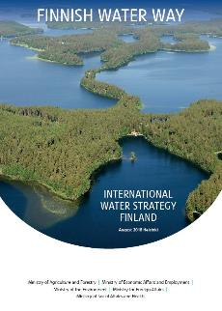
Water diplomacy & Finland
Combines two Finnish strengths:
Our work on peace mediation…
Compr. crisis management, women & peace work (UNSC res. 1325)
& facilitation of Development-Humanitarian-Peace triple nexus
Finnish expertise (incl. CMI) combined with support to
key international actors such as UN, EU and OSCE
…with commitment to water cooperation
Finland initiated both global water conventions:
UNECE 1992 and UN 1997 (and Helsinki Rules 1966)
Our own transboundary cooperation well-functioning
Building on long tradition in both transboundary cooperation
(Mekong, Nile, Central Asia) and peace mediation & conflict resolution
Slide source: Dr. Marko Keskinen, Aalto University
→ Water + peace

Slide 3
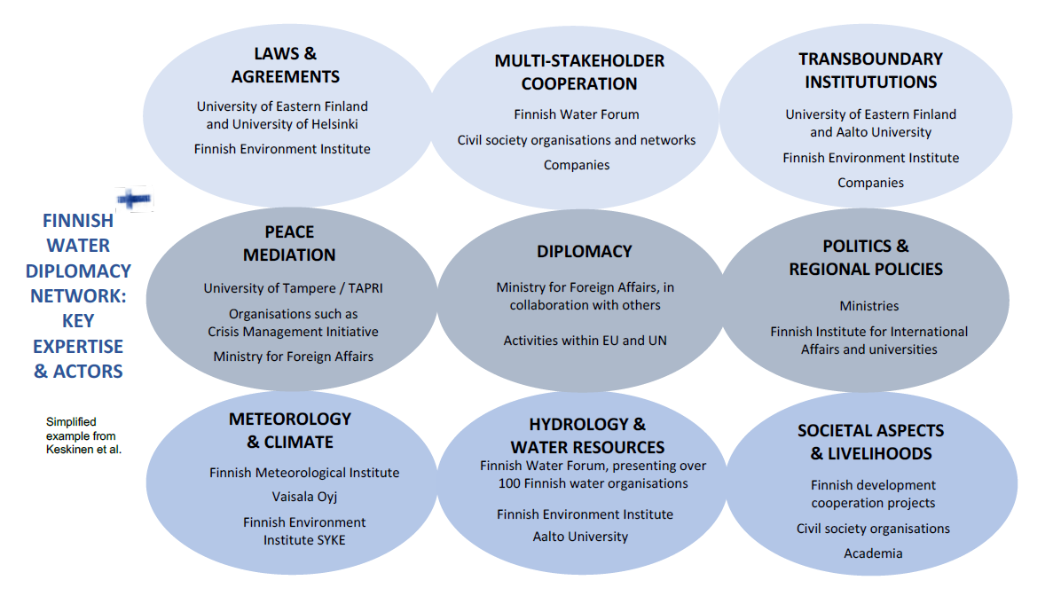
Finnish capabilities for water diplomacy – institutions within the Water Diplomacy Network
Source: Brochure on Finnish Water Diplomacy Expertise 2020

Slide 4
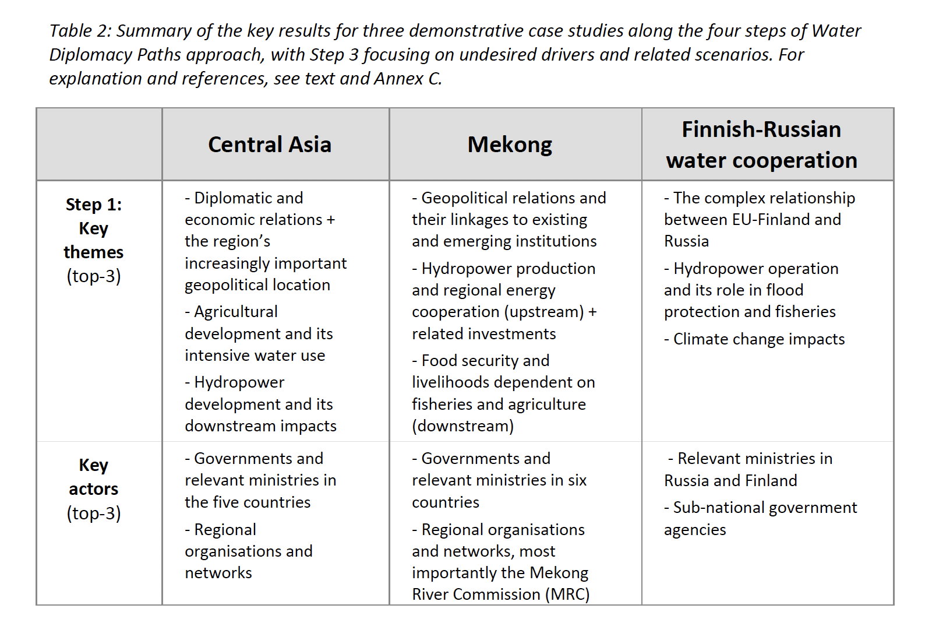
Cases
Details in the article
https://doi.org/10.1016/j.jhydrol.2021.126737

Slide 5
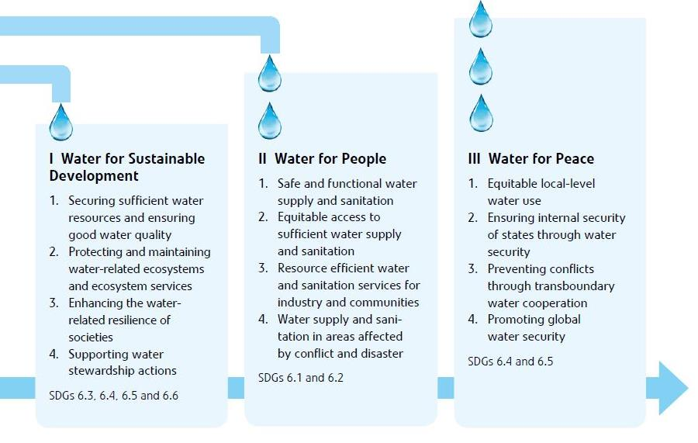
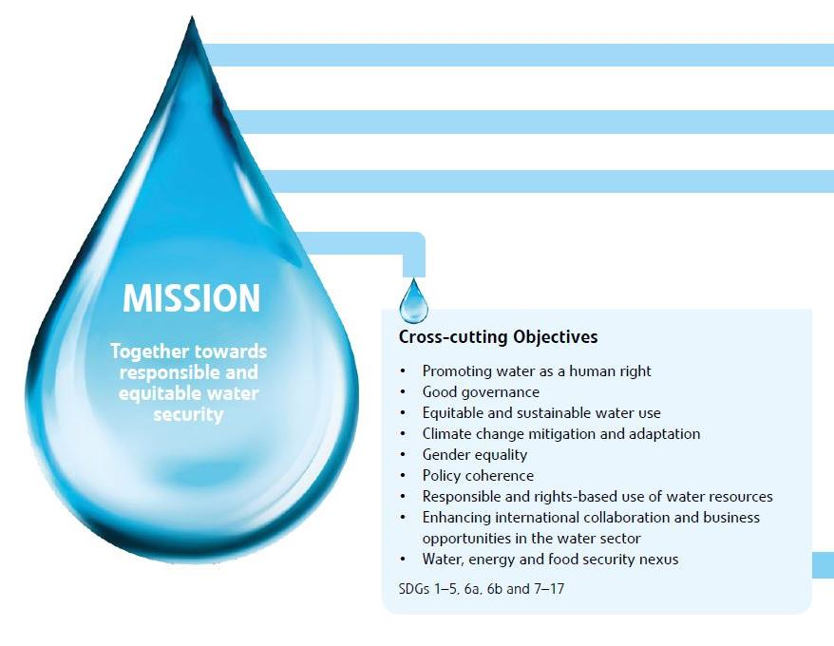
Finnish Water Way: three pillars

Slide 6
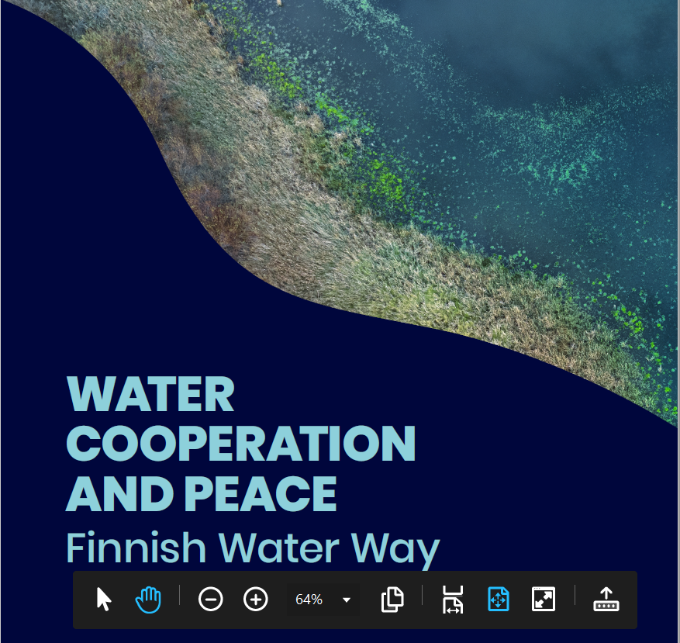
https://issuu.com/suomenymparistokeskus/docs/water_cooperation_and_peace

